Slide 1
Final Project Briefing Regenerative Speed Reducer (RSR) -- JASMA (G9)--
AME 410: Engineering Design Theory and Methodology
1) Jim (Wei-Chih Hsu)
2) Amir (Amir Nader A Ghazvini)
3) Sherlock (Chung-Hau Wang)
4) Minnie (Chu-Yi Wang)
5) Andy (Zihao Lu)
December 4, 2013

Slide 2
Problem & Goals
Reduce car speed in desired place and time
Regenerate wasting energy of car's braking
Related to Traffic issue
Related to Energy issue

Slide 3
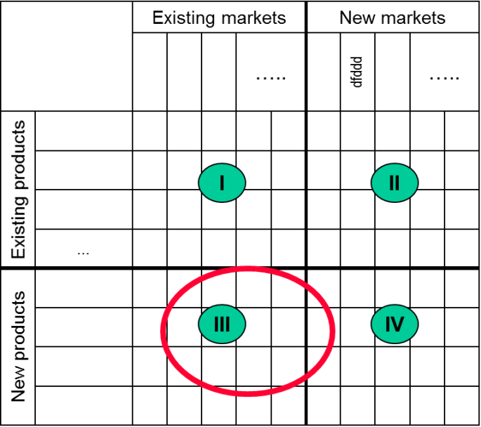
Market and Customer
Our market
National market
Targeted users and customers
Government
Urgent situation users
Energy regeneration aim users
Traffic control aim users
Citizens
Drivers
Parking owners
Manufacturer

Slide 4
Customer Requirements
Types of customer requirements
Functional performance | Life-cycle concerns
High energy transformation High energy storage Much speed reduction | Ease of energy reuse Good maintainability (long life time) High stability of energy source Environment protection
Human factors
Comfort Good appearance
Physical requirements | Resource concerns
Small underground placement Good damage prevention Absorbing impact | Less manufacture cost Much funding or many sponsors
Reliability | Manufacturing requirements
Good robustness High safety | Easy manufacturing Low equipment cost High quality

Slide 5
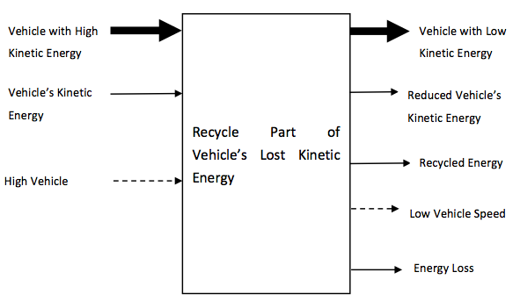
Overall Function
Speed

Slide 6
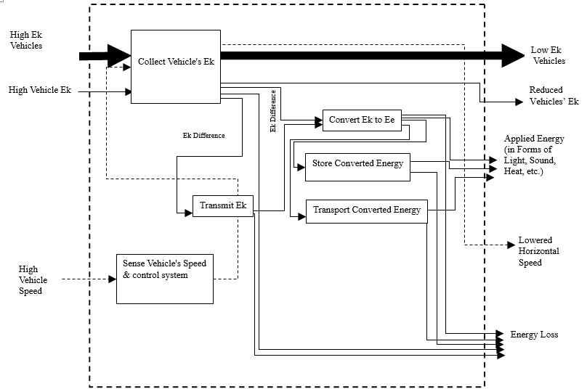
Function Structure

Slide 7
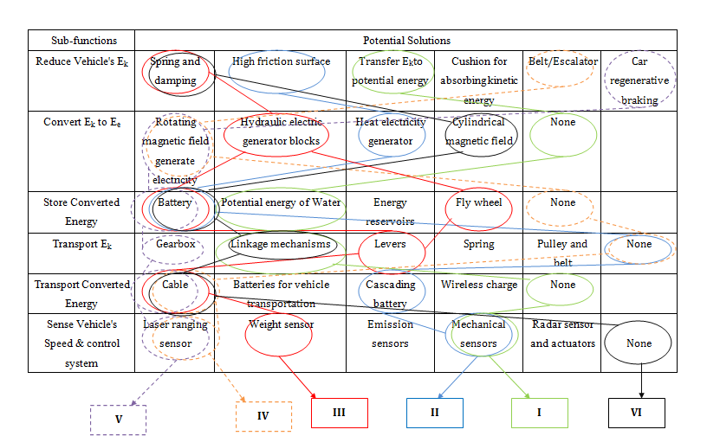
Morphology Chart & Variants
Collect Vehicle’s Ek

Slide 8
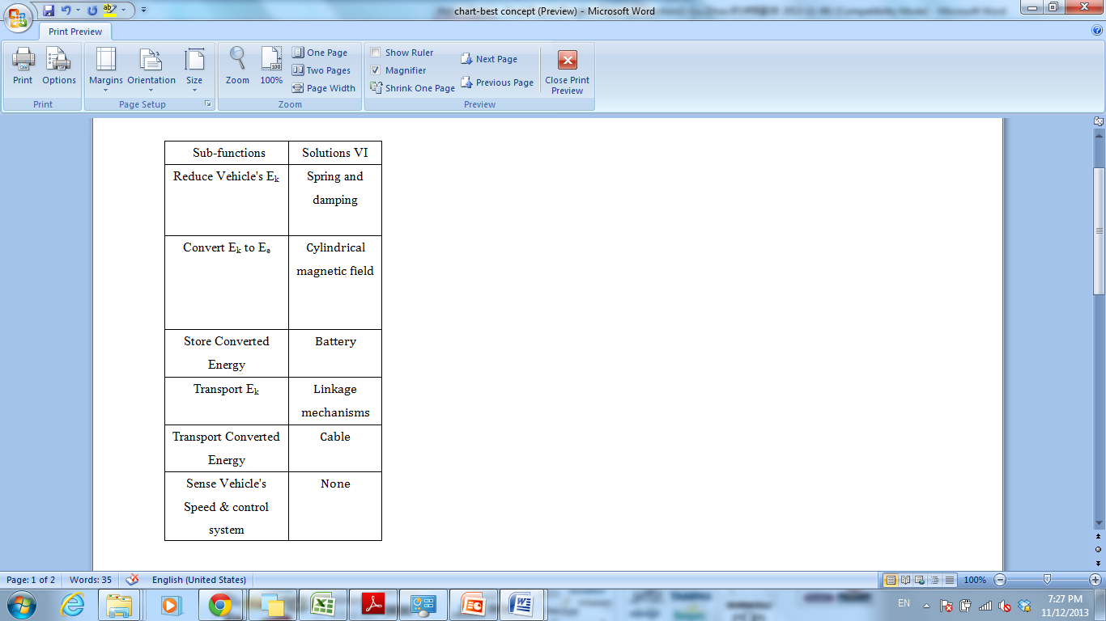
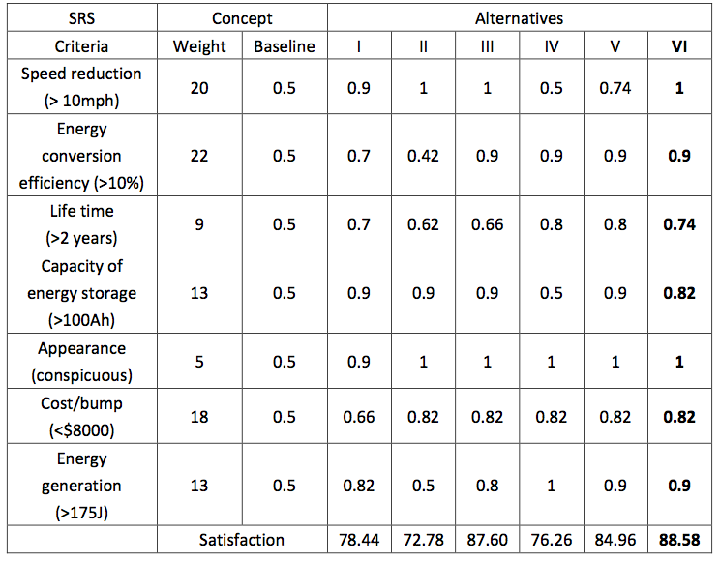
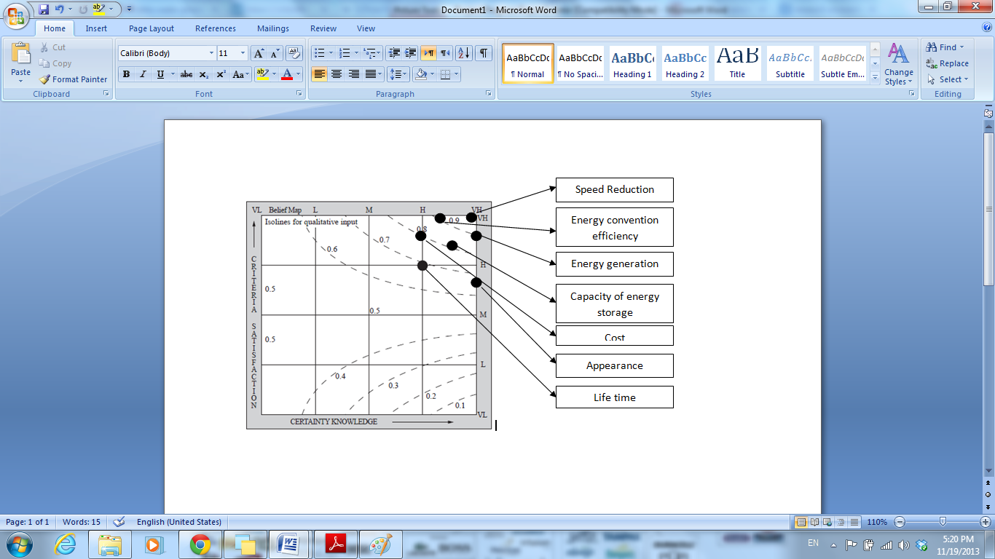
Evaluation of Variants

Slide 9
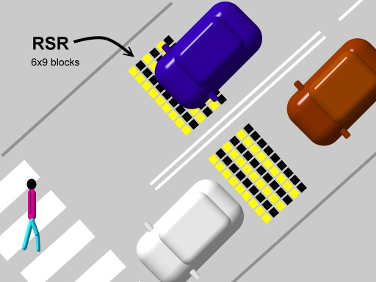
Prepare for Product Design
a scale drawings of spatial constraints
Width
Ordinary car: ~1.5 m
Ambulance: ~2.0 m
Fire engine: ~2.5 m
Lane: ~3.5m
RSR total width: 1.5~2.0 m
~1.5 m
~2.5 m
1.5 ~2 m
3.5 m

Slide 10
Prepare for Product Design
Embodiment-determining requirements
Ek→Ee Energy conversion rate: >30%
Battery capacity: > 30 Ah/unit
Main Materials: Plastic, Copper, Rubber, and Steel
Working cycle: > 5years
Speed reducing: ~ 20%
Passing speed range: < 65mph
Electricity generation: > 2x10⁻⁶ kWh/unit
Loading weight: < 30 tons

Slide 11
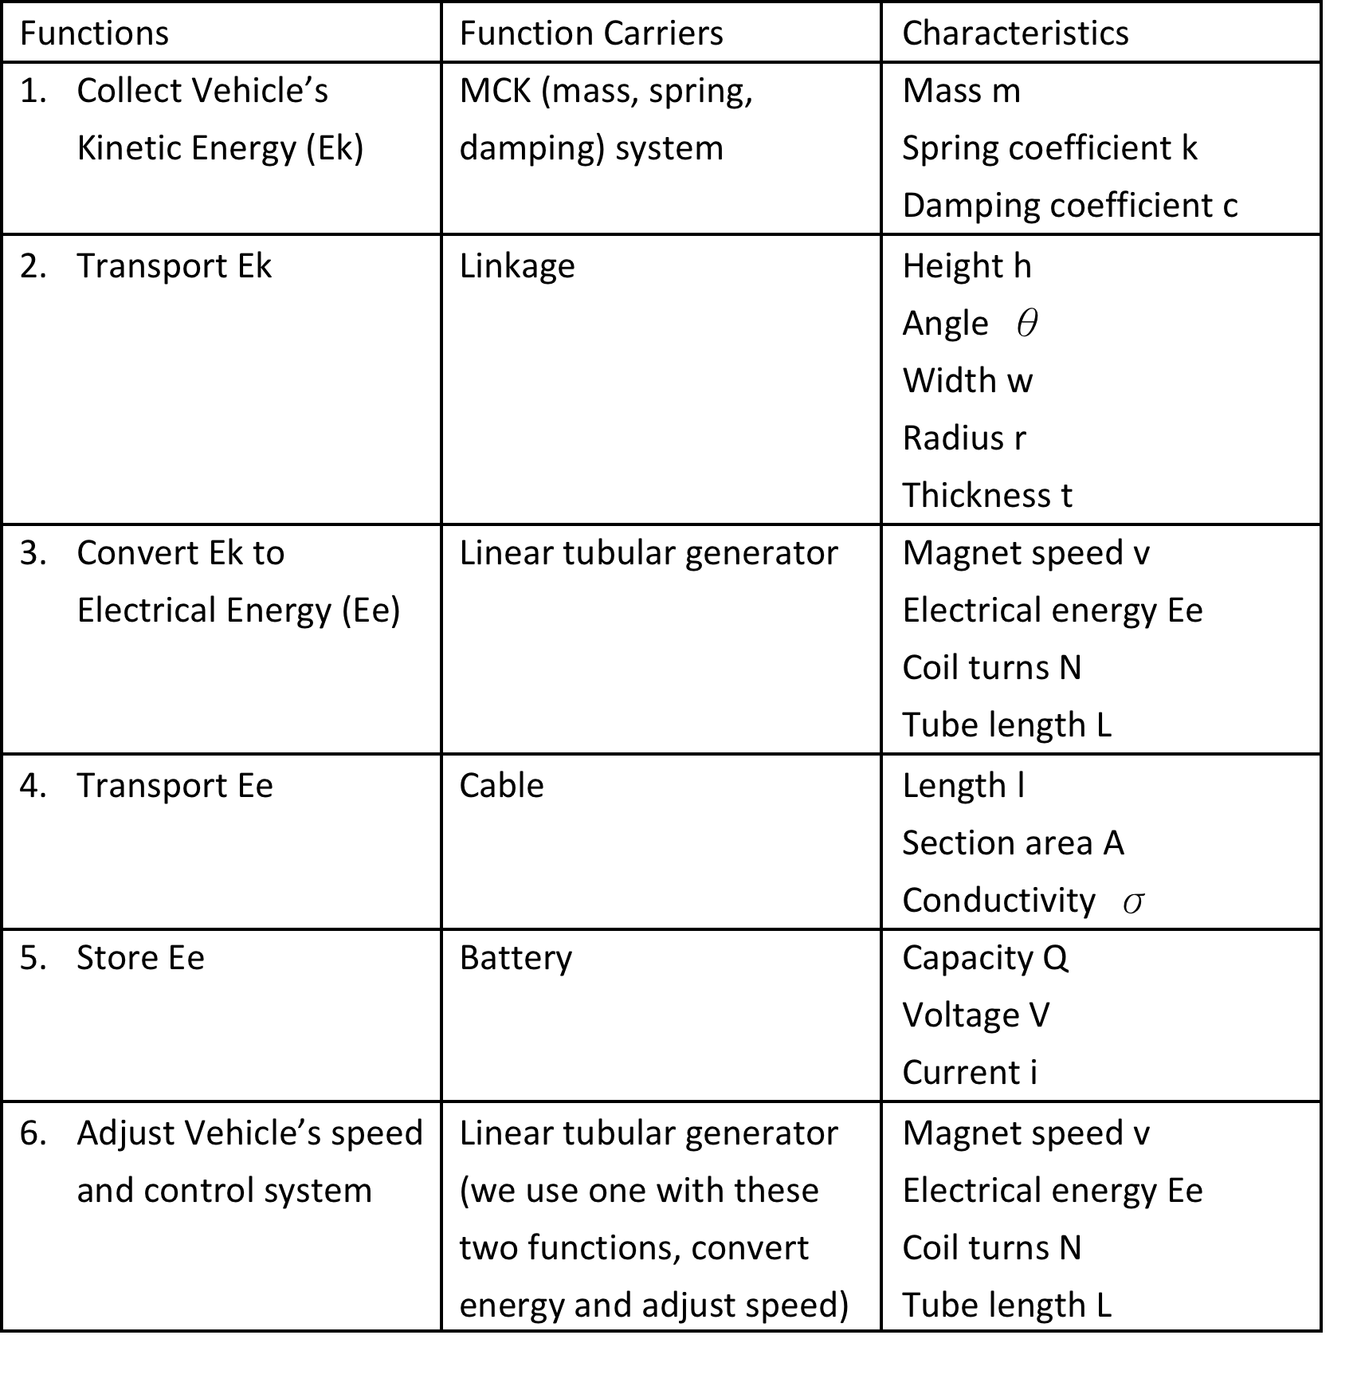
Main Function Carriers

Slide 12
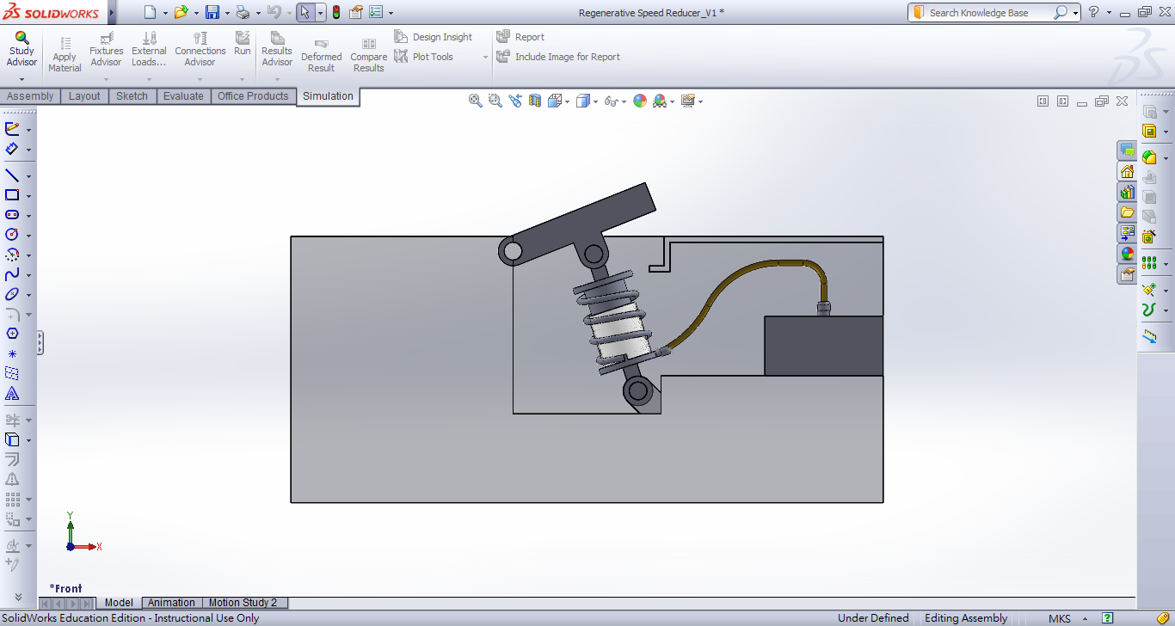
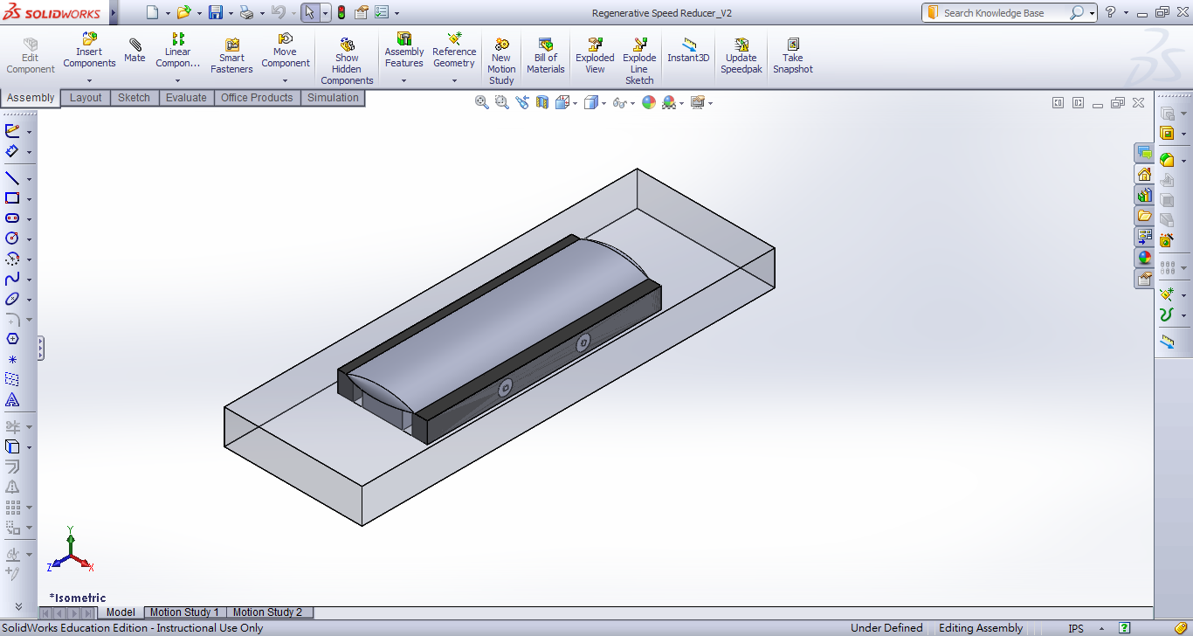
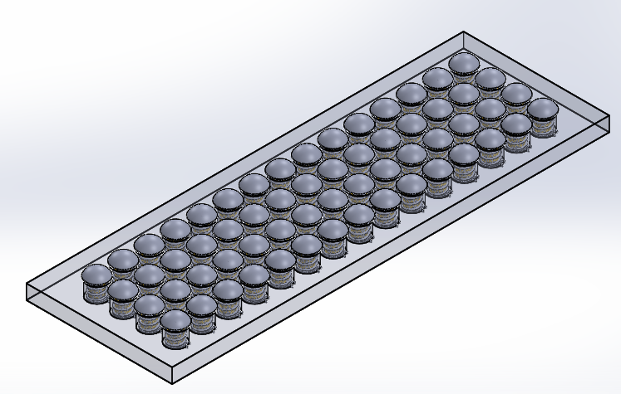
Prototypes

Slide 13
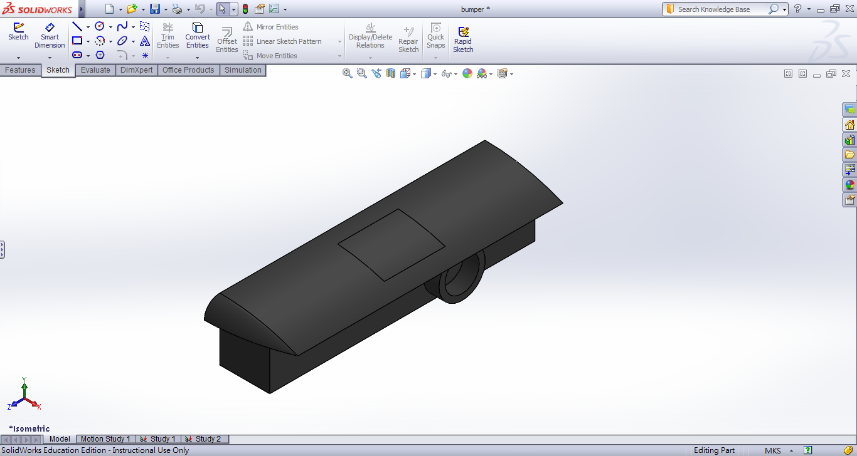
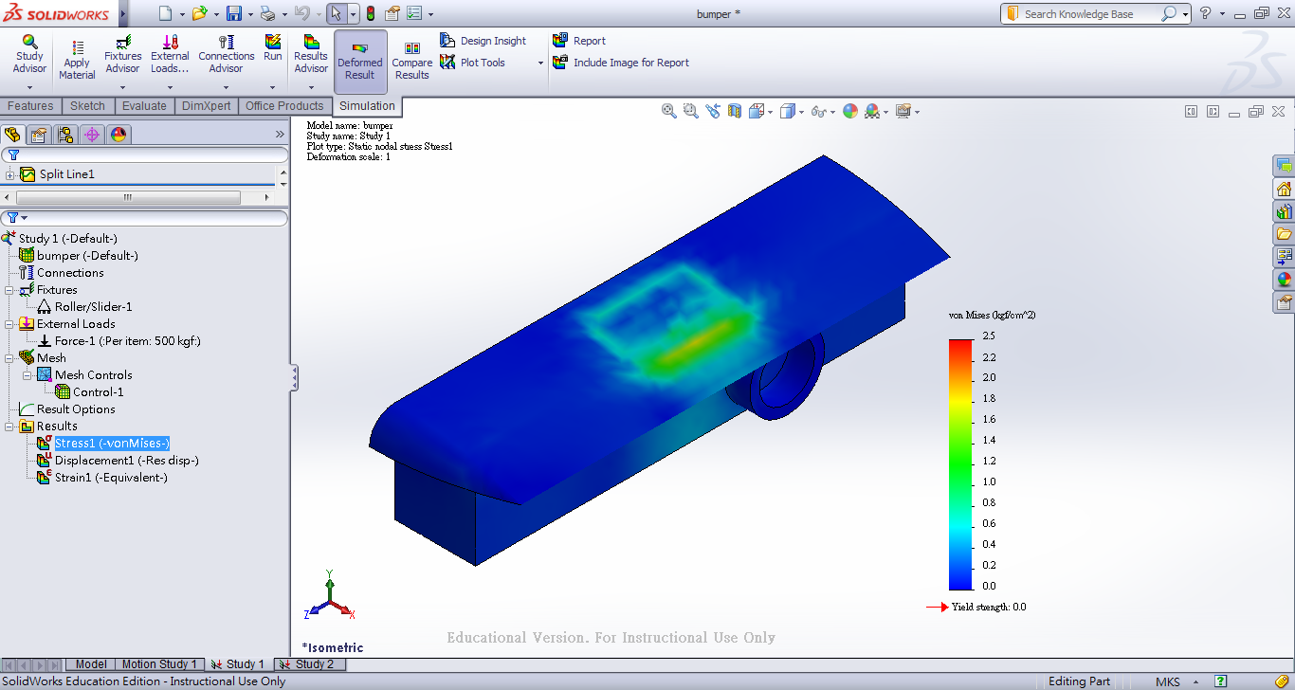
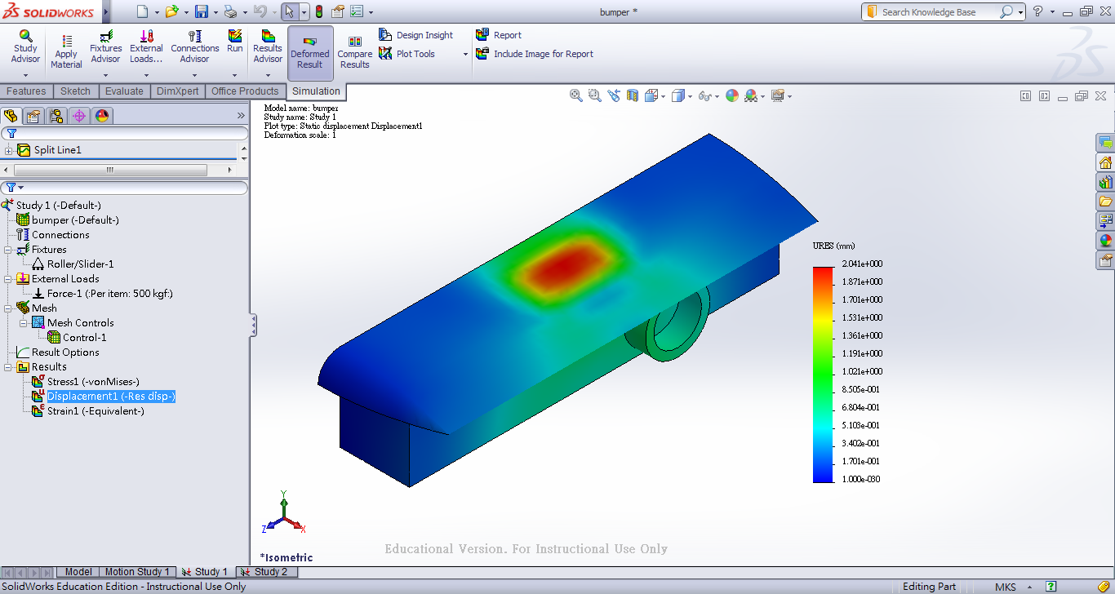
Final Design & Size
Stress Deformation
0.195^{(m)}
0.15^{(m)}

Slide 14
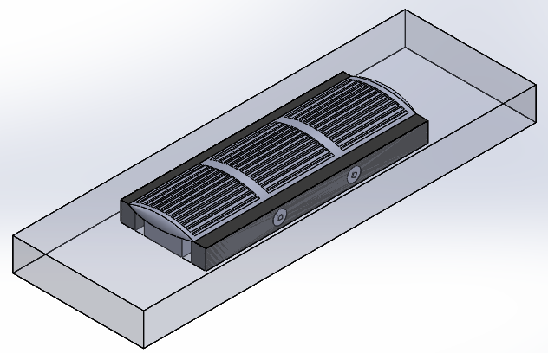
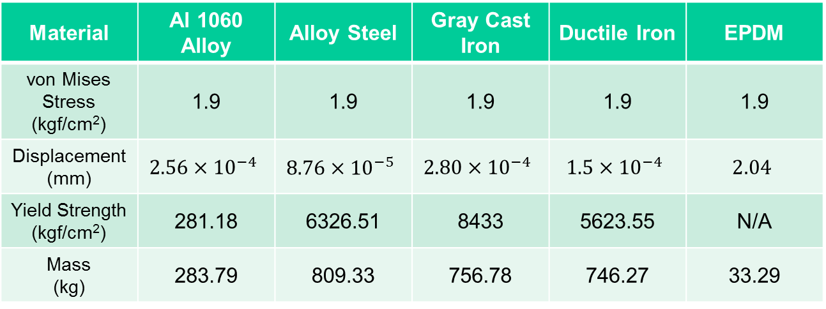
Final Design & Size
0.5^{(m)}
1.7^{(m)}
0.15^{(m)}
Material | Al 1060 Alloy | Alloy Steel | Gray Cast Iron | Ductile Iron | EPDM
von Mises Stress (kgf/cm²) | 1.9 | 1.9 | 1.9 | 1.9 | 1.9
Displacement (mm)
Yield Strength (kgf/cm²) | 281.18 | 6326.51 | 8433 | 5623.55 | N/A
Mass (kg) | 283.79 | 809.33 | 756.78 | 746.27 | 33.29

Slide 15
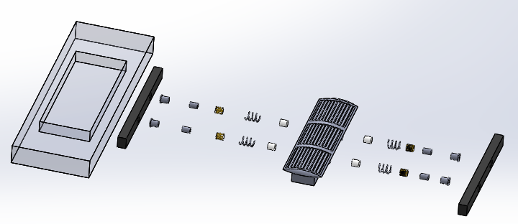
Material Selection
Cylinder | Coil | Wrap | Bump | Spring | Magnet | Shock Absorber
PVC | Litz Wire (Copper) | Plastic | EPDM (Rubber) | Steel | NIB (Neodymium Magnet) | Rubber

Slide 16
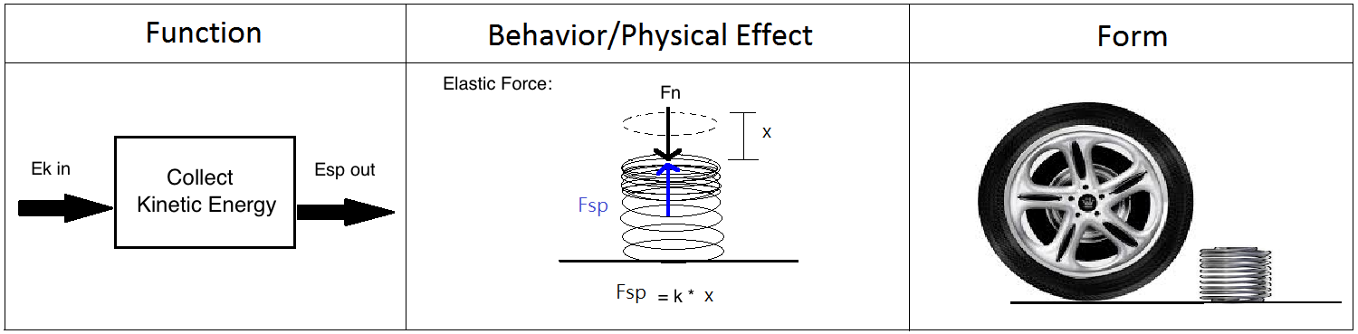
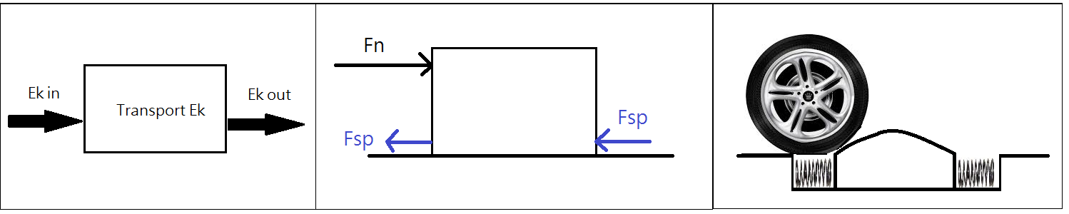
Use of components principles

Slide 17
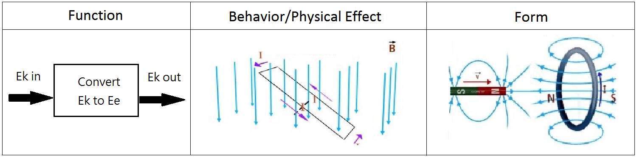
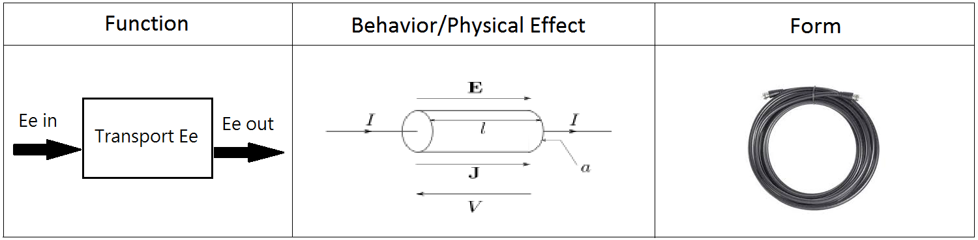
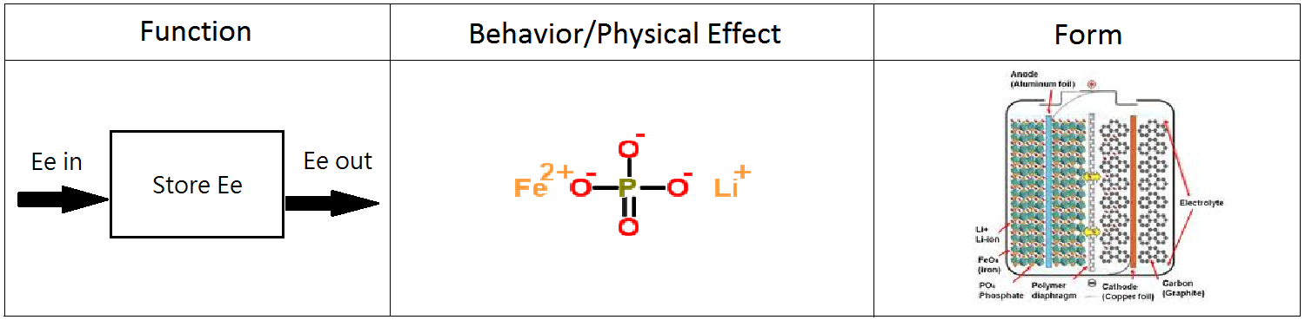
Use of components principles

Slide 18
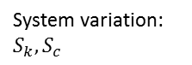
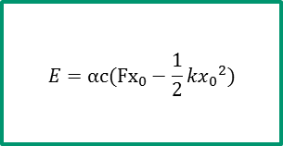
Performance Evaluation
1. P-Diagram
Absorbing Energy
$$E=αc(Fx_{0}−\frac{1}{2}k{x_{0}}^{2})$$
Energy absorbed: E
The stiffness: k
The Damping ratio: c
In this case we can see we take the spring stiffness as well as the damping ratio of the system (which uses the linear tubular generator) as the controllable parameter of the system, and decides how much energy will be absorb during the process.

Slide 19
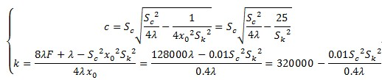
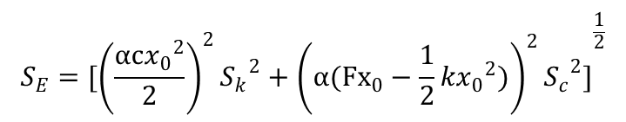
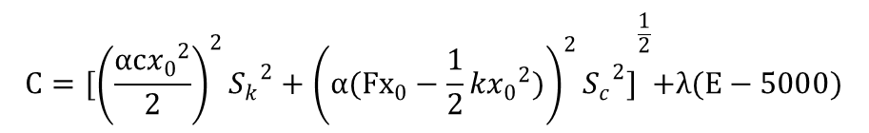
Performance Evaluation
2. Error Propagation
$$S_{E}={[{\left(\frac{αc{x_{0}}^{2}}{2}\right)}^{2}{S_{k}}^{2}+{\left(α(Fx_{0}−\frac{1}{2}k{x_{0}}^{2})\right)}^{2}{S_{c}}^{2}]}^{\frac{1}{2}}$$
3. Optimization Problem
Using differential to find the minimal of C
$$C={[{\left(\frac{αc{x_{0}}^{2}}{2}\right)}^{2}{S_{k}}^{2}+{\left(α(Fx_{0}−\frac{1}{2}k{x_{0}}^{2})\right)}^{2}{S_{c}}^{2}]}^{\frac{1}{2}}+λ(E−5000)$$

Slide 20
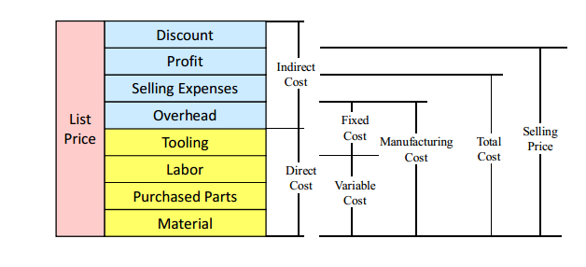
Cost Evaluation
Direct Cost
 | MSD system | Tubular linear generator | Battery | Linkage mechanism | Cable | Sum
Tooling | $20 | $0 | $5 | $30 | $0 | $55
Labor | $15 | $10 | $10 | $5 | $5 | $45
Purchased parts | $20 | $500 | $50 | $0 | $10 | $580
Material | $0 | $0 | $0 | $20 | $0 | $20
Sum | $55 | $510 | $65 | $55 | $15 | $700

Slide 21
Cost Evaluation
Indirect Cost
 | Description | Cost
Overhead | Transportation and Installation | $45
Selling Expenses | Unique customers | $10
Profit | 15% | $135
Discount |  | $0
Sum |  | $190

Slide 22
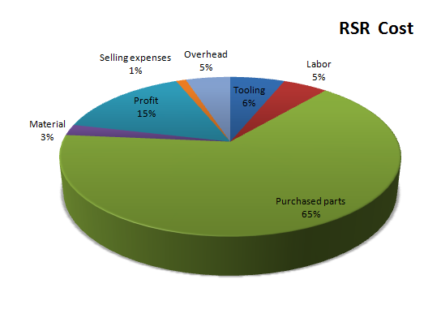
Cost Evaluation
Total: $890

Slide 23
Pros and Cons
 | RSR | Hybrid car | Speed bump | Stinger Spiker
Speed Reduction | Automatically Adjust (~20%) | N/A | ~10 mph | Stop
Power Generation | Less Control Loss | More Control Loss | N/A | N/A
Energy Applied Targets | Wide application e.g. Street Lamps, Traffic Lights, Speed Meters | Only for car itself | N/A | N/A
Cost | $890 | > $20,000 | ~$30 | ~$10
Car Damage | Very slight wear | No | A little bit | All Tires
Lifetime | ~10 years (Battery: ~5 yrs) | ~10 years | ~10 years | Replace Spikes Every Time

Slide 24
Lessons learned & Summary
Lessons learned
Understand more about the designing methodology
Have more understand of the different type of traffic damper product
Have more understand of the energy absorbing system
Have a great chance to going through a full procedure of doing a design project
Summary
Given the energy we can save in the future, our price for the damper is acceptable. Our design might be very promising

Slide 25
Thank you for your attention!
Q&A

